Slide 1
Generalized Overlapping Group Lasso for Patients Subgroups Selection
Wenxuan Deng

Slide 2
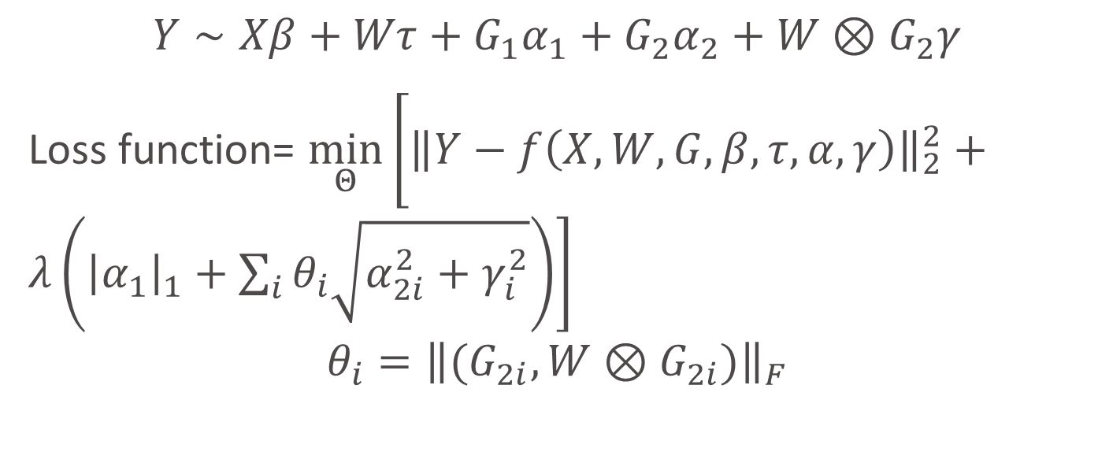
Model
Baseline Variable
Treatment Variable
Main/Interaction Effects of Genes
$$Y∼Xβ+Wτ+G_{1}α_{1}+G_{2}α_{2}+W⊗G_{2}γ$$
Loss function= $\min_{Θ}\left[{\left\|Y−f\left(X,W,G,β,τ,α,γ\right)\right\|}_{2}^{2}+λ\left({\left|α_{1}\right|}_{1}+\sum_{i}{θ_{i}\sqrt{α_{2i}^{2}+γ_{i}^{2}}}\right)\right]$
$$θ_{i}={\left\|(G_{2i},W⊗G_{2i})\right\|}_{F}$$

Slide 3
Simulation Setup
N=100
Dimensions for baseline variables = 2
Dimensions for treatment variable = 1
Dimensions for Genes = 20
30% of 20 gene main effects are non-zero
20% of 20 hierarchical interaction effects are non-zero
Iterations: 100

Slide 4
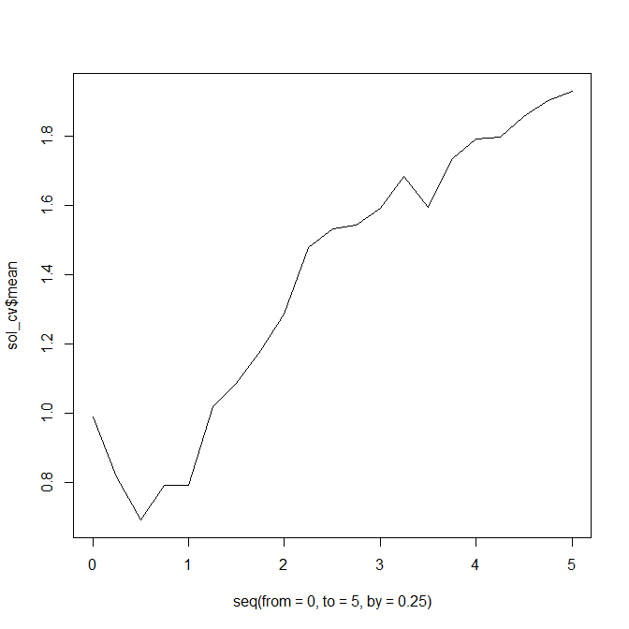
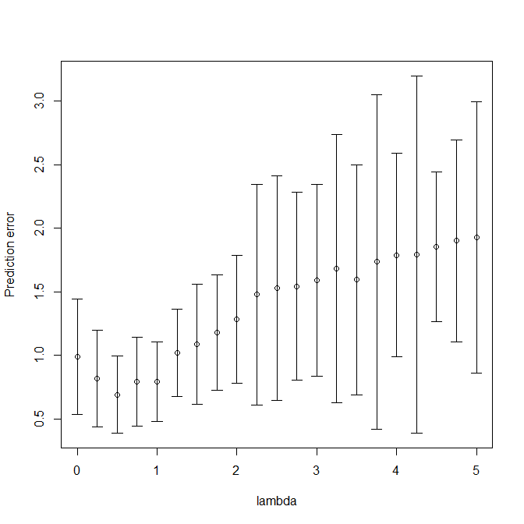
10-fold Cross Validation

Slide 5
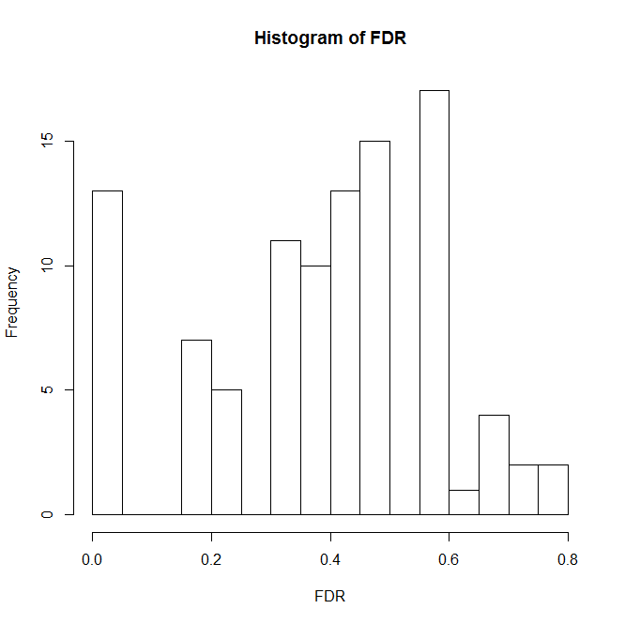
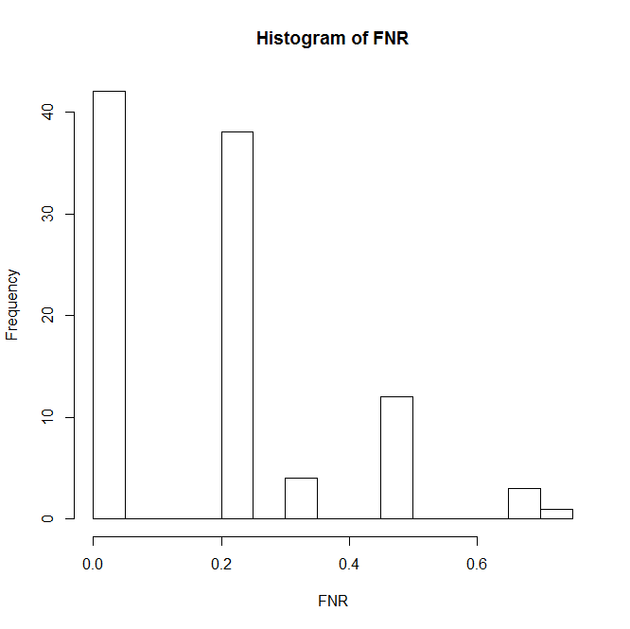
FDR and FNR distributions on Interaction Estimation after cross validation
FDR mean=0.396
FNR mean=0.196

Slide 6
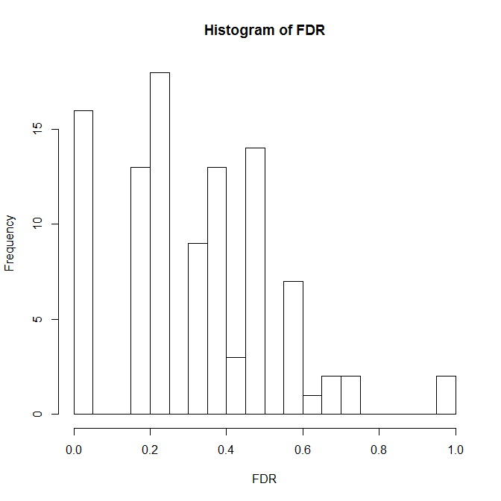
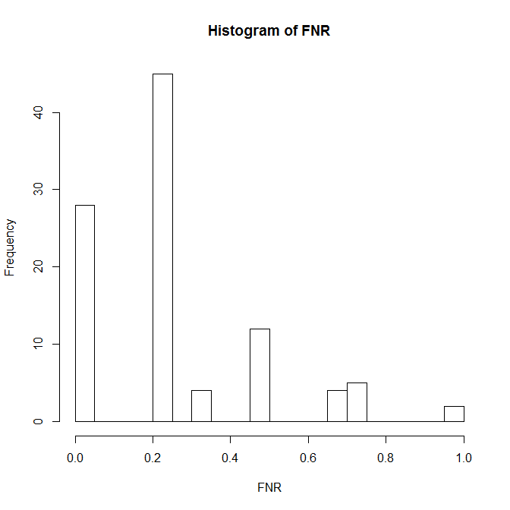
FDR and FNR when λ=0.75
FDR Mean=0.33
FNR Mean=0.27

Slide 7
Possible Reasons for Poor Performance
Some false discoveries were induced by minor noises, which could be discarded by selecting top main/interaction effects with stronger signals.
Solution: Only keep top non-zero interaction effects ( i.e. 20% out of 20 interactions)

Slide 8
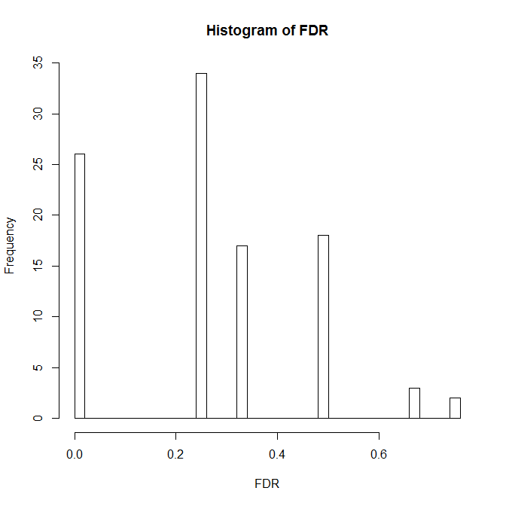
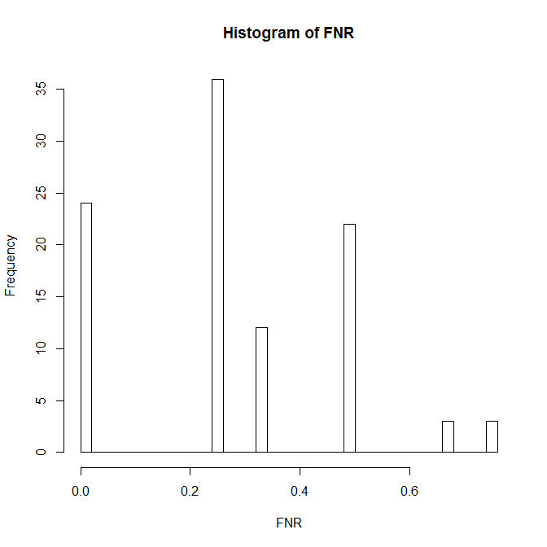
After top selection
FDR mean=0.27
FNR mean=0.2825

Slide 9
Possible Reason for Poor Performance
Example (Next slide)

Slide 10
